Slide 1
COP Face to Face
Learning from COVID-19. How COVID-19 Social Protection Shock Response Interventions Have Been Integrated into National Policies
Day 2, Session 3
June 23rd, 2021
COVID-19 Response through the Urban Productive Safety Net Programme (UPSNP)
Ethiopia

Slide 2
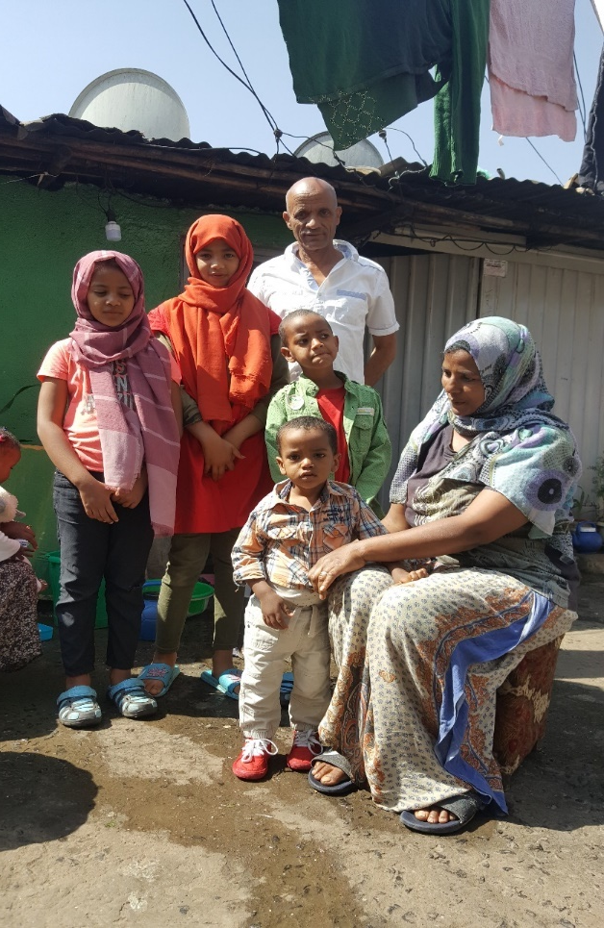
COVID-19 response through vertical expansion
Coverage: First time a cash ‘top-up’ approved for Urban and Productive Safety Net Programme (UPSNP) clients:
93,120 PDS clients (elderly, chronically ill, PwD etc.)
17,460 TDS clients - pregnant and breastfeeding women
Amount: ~9 USD per HH (67,510)/per month for 6-months
Geographical coverage: 11 cities

Slide 3
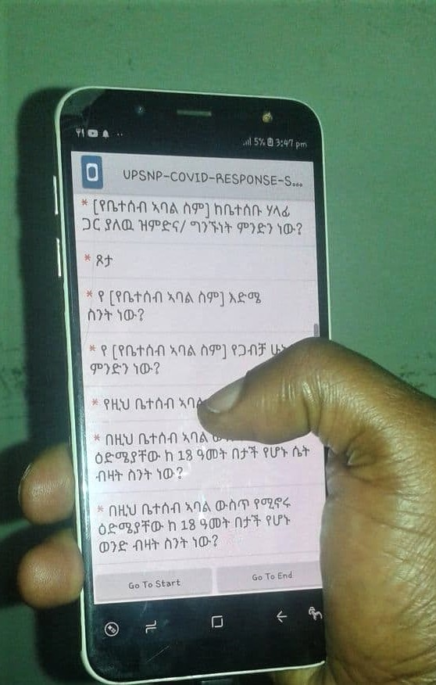
Adapting the UPSNP systems
Updated the UPSNP payroll software (UPASS) to enable the triggering of ‘top-up’ payments to existing clients
Deployed enumerators using the mobile application KoboCollect to conduct post distribution monitoring across the intervention cities

Slide 4
Further integration of shock responsive innovations in UPSNP
UPASS now able to provide top-ups for existing clients and is being updated to allow payments to IDPs
KoboCollect being further integrated for future shock responsive interventions
UPSNP is now expanding to cover IDPs in Mekelle (Tigray) for the first time

