Slide 1
COP Face to Face
Learning from COVID-19. How COVID-19 Social Protection Shock Response Interventions Have Been Integrated into National Policies
Day 2, Showcasing Operational Innovation
June 23rd, 2021
Taking Lessons From Covid Sp Response Forward
Urban Focus
Malawi

Slide 2
INNOVATIONS The use of digital tools
Online Registration Monitoring App
Data collection monitoring was essential for data quality
Enumerators normally collect data unsupervised. Sometimes they:
Lack knowledge or skills
Focus on speed, not quality
Are not motivated
Act unscrupulously
This can lead to poor quality data being collected
By regularly checking the data collected by enumerators, issues can be identified, and enumerators can be:
Provided feedback and coaching
Re-trained
Disciplined or fired

Slide 3
INNOVATIONS The use of digital tools
Online Registration Monitoring App
An online APP was developed to monitor HH reg
The APP was able to access data from the social registry/UBR portal and provide daily analysis
Households were flagged based on any of these (outlier xcteristics:
Outside hotspot
Low GPS accuracy
Wrong or odd phone numbers (
HH size >20 members
Survey time under 3 minutes
Have the same phone number as other households
Potential duplicate using survey responses and GPS location
http://covid19.mnssp.org

Slide 4
INNOVATIONS The use of digital tools
Online Registration Monitoring App

Slide 5
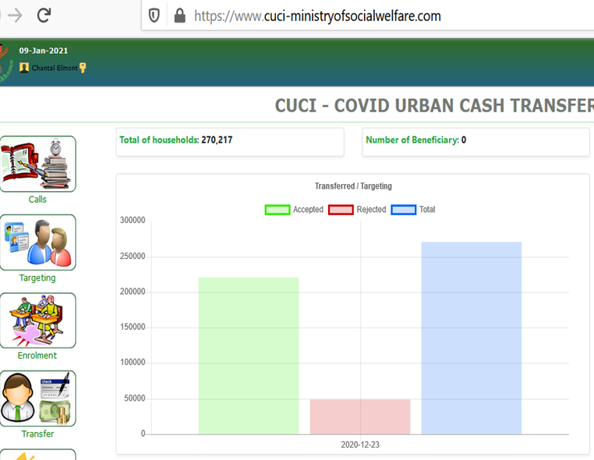
The use of digital tools
CUCI MIS
HH data is transferred from the UBR
To the CUCI-MIS through an API
Eligibility criteria verification to all HHs
HHs that meet the criteria receive the status “eligible” -Accepted
While HHs that do not meet the criteria receive the status “ineligible - Rejected

Slide 6
The use of digital tools
Call center – officers manning the call center
CALL CENTER –A national call center was set up to facilitate a remedial action for complainants
Capacities for 8 officers were built on the functions of the Call Centre
Long term this will act as a Single Window Case Management System which will be extended to all social issues such as Human Trafficking, Domestic Violence, Rape Cases, Child Labour, Child and Early marriages
Offers one toll free line 350
So far received 187 cases out of which 105 related to child abuse

Slide 7
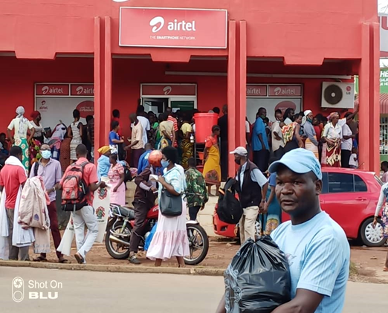
The use of digital tools
Beneficiaries cashing out
PAYMENT thru MNO
Payment was done through Mobile Network Operators (MNO)
Was the first time (Social) Cash Transfers to use this avenue
The uptake of e-payments is in line with GoM Payment Road Map to develop payment solutions that promote financial inclusion, accountability, efficiency, and transparency of payment systems in addition to improving cost efficiency.

Slide 8
Thank you Any questions?

